Slide 1

The power of maths
Notes:
Today I am going to talk about Axiom Maths and how it could help you unlock a super-power.
Maths gives us power. It teaches us to imagine things never before imagined. It helps us to solve unsolvable challenges.

Slide 2

What if you had the power…
To find the cure for cancer?
To stop climate change in its tracks?
To invent pollution-free travel?
To master artificial intelligence?
To end unemployment?

Slide 3
Maths gives you that power. And it can be yours, no matter your backgound.
Notes:
Maths holds the answer to all of these problems. It teachers us to see beyond what others see. To imagine what was never before imagined. To solve challenges others thought unsolvable. The world’s great problems cannot be solved without maths.

Slide 4

Maths gives you the power to do good, and earn well
10%
£500k
Higher salary
More lifetime earnings
If you have maths A Level, compared to someone else doing the same job
With a maths degree compared to someone with another degree
Notes:
People who get a maths A level will on average earn 10% more than someone doing an identical job but who doesn’t have a maths A level.
People who get a maths degree will, on average earn £500,000 more over their lifetime than someone with a degree in another subject.

Slide 5
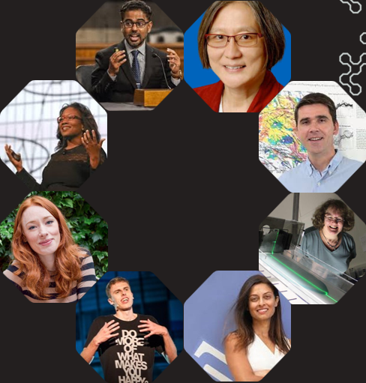
Perhaps the only mathematicians you know are your maths teachers, but mathematicians are working everywhere…
Notes:
Maybe the only mathematicians you know are your maths teachers, but mathematicians are working everywhere…
Mathematicians are not often in the public eye and pupils often don’t know where maths could take them! Everyone knows it’s a good idea to get a GCSE in maths, but what about after that? These people all studied maths beyond school and now work as mathematicians in a huge variety of exciting and important work!
You may want to ask the pupils to guess which person does what
[For reference… clockwise from the top right (woman in glasses and red jacket):
Climate change: Inez Fung
Natural disaster prediction: Yuri Fialko
Aerospace engineering: Andrea Bertozzi
Pandemic response: Devi Sridhar
Slam poet: Harry Baker
Human behaviour analysis: Hannah Fry
Health and environment: Talithia Williams
AI: Prasanna Balaprahesh ]

Slide 6

Sergey Brin
Loved solving puzzles and doing cool experiments when he was young
This passion for puzzles led him to inventing Google from his garage
Currently works for Space Adventures, launching rockets into space
Notes:
Sergey Brin is one of the amazing brains behind Google! Imagine creating something that millions of people use every day to find answers to their questions. Sergey loved solving puzzles and doing cool experiments as a kid, and that passion led him to team up with his friend Larry Page to invent Google in a garage! Today, Sergey helps launch rockets into space with a company called Space Adventures and even explores futuristic tech like self-driving cars. He turned his love for science and maths into awesome inventions that changed the world!

Slide 7
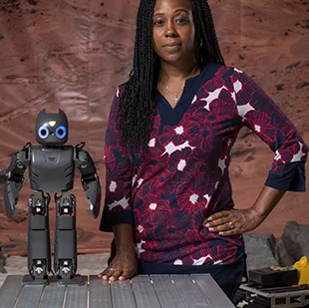
Ayanna Howard
When she was young, she loved building things
This passion led her to working for NASA where she created robots that drove on Mars
She also developed robots to measure climate change in Antarctica and to help children with special needs
Notes:
Ayanna Howard is a real-life robotics genius! When she was young, she loved building things and dreaming about robots. That passion led her to work at NASA, where she helped design robots to explore Mars! Imagine creating a robot that could drive around on another planet! Ayanna didn’t stop there—she now creates robots that help people in their everyday lives, like cool robots that can assist kids with disabilities. She’s also a professor, teaching the next generation how to build amazing robots. Ayanna used her fascination with technology to create robots to change the world for the better!

Slide 8
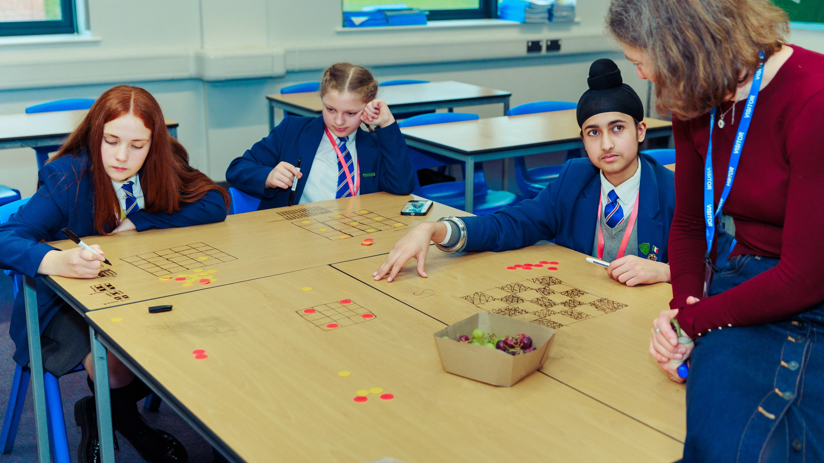
How Axiom Maths can help you unlock your power
Notes:
As you’ve seen, both of those amazing people who have gone on to do extraordinary things started out by doing puzzles and experimenting with problems. We want to give you this opportunity. To explore maths without any tests or exams in a fun environment. Who knows where it will lead you?

Slide 9
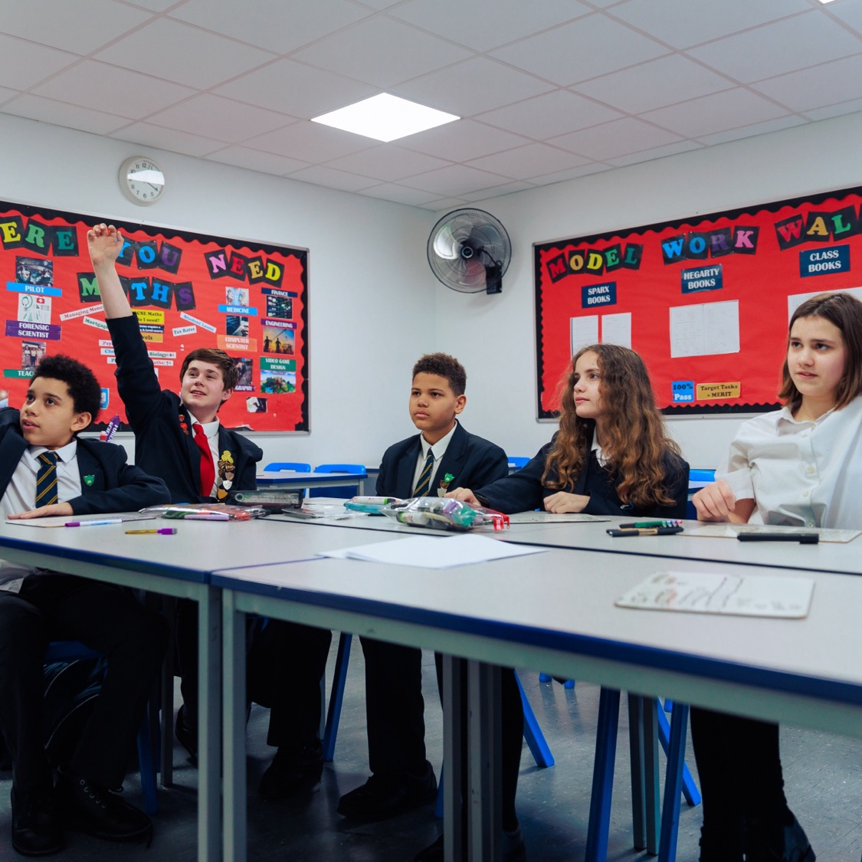
What are Axiom Maths circles?
Grapple with intriguing problems and ideas
Learn to think, speak and work like a university mathematician
Sometimes think on your own, sometimes think in a team
Enjoy getting stuck as well as getting unstuck
Notes:
Axiom Maths runs maths circle and they are our most important tool in helping you realise your power! In Axiom maths circles, pupils like you gather to tackle intriguing and enjoyable maths challenges together.... but it’s different from your maths classes. You'll discuss topics you normally don't get to, solve puzzles, play games, and work through fascinating maths problems. You'll be joined by others in your year who love maths as much as you do. Maths circles will help you to become more confident inside and outside of the classroom and push you to grow in exciting and rewarding ways!

Slide 10
“Everything in Axiom Maths is amazing. I just wish we could do it twice a week as it's really fun and challenges me each time.”
Pupil quote

Slide 11
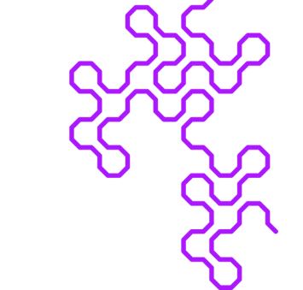


Axiom Maths: not just maths circles…
Wider Axiom opportunities
Summer School
Fields Trips
Year 7
Year 11
Axiom merchandise
Celebration days
GCSE help
Notes:
The Axiom programme is more than just maths circles. Unlike normal clubs, with Axiom Maths, you get to participate throughout all secondary school. Each year you get to take on new, and exciting maths subjects. The maths will grow with you! But joining the programme isn't just participating in maths circles. There are tons of cool exclusive activities and events that you will be invited to. For example, this last summer, Axiom Maths hosted our first ever summer school at Cambridge university. We also hosted field trips for 20 schools. We did tons of maths together, heard interesting and exciting talks from maths PhD students and professors, and got to connect with like minded peers who also love maths. At our events, you get to meet other mathematicians from different schools, who love a challenge as much as you do.

Slide 12





Axiom Maths circles in your school
When?
Where?
What's next?
Find out more
Other extra curricular maths opportunities
When are maths circles?
Where?
What pupils should do next…
Find out more at www.axiommaths.com
Any other extra curricular maths opportunities at your school…
Notes:
For schools to edit for their own circumstances

Slide 13
Maths circle taster!
Notes:
Run through the following slides in assembly. This should only take 5 minutes

Slide 14
Prime time!
Can you use all the digits 1 to 9 once each to make six prime numbers less than 100?
??
??
??
?
?
?
?
?
?
Notes:
*Presenters should have worked on this problem themselves in advance of the presentation*
If pupils have pencil and paper, this would be helpful but not essential. A whiteboard for the presenter to jot answers on might also be preferred.
It is more important that students have time to engage with the problem than that they completely solve it or see a solution shown, so if time is limited, use it for pupil engagement.
Tell the prospective mathematicians that this is an example of a maths problem, and that
you don’t do maths problems by trial and error, or by guesswork, or by luck;
you use what you know about numbers,
and you think hard.
You may like to use some/any of the following questions to clarify meanings, support thinking and guide students:
What is a prime number? Is 1 a prime number?
What is a digit? What does each of the ?s represent?
It is important, once the question has been understood, to give pupils time to grapple with, play with and discuss the problem to embed their understanding of what the question is asking. We suggest a few minutes.
Can you suggest a prime number that might be one of the primes we are looking for?
Can you say whether the numbers we are looking for are 1-digit or 2-digit numbers?
(Click) for the animation showing three 1-digit numbers and three 2-digit numbers. Again this may be a moment to pause to allow more student work.
What might the single digit numbers be? What could they NOT be?
What do you know about the odd/even-ness of prime numbers? So where can you put the 4,6 and 8?
Where can 5 go? Where can’t 5 go? Why not?
Where can 2 go? Where can’t 2 go? Why not?
Where can 1,3 and 7 go?
The next slide is a prime number checker, so that you don’t need to remember all the primes to 100 – and nor do the students!

Slide 15
Prime time!
Here are the prime numbers less than 100.
 | 11 |  | 31 | 41 |  | 61 | 71
2
3 | 13 | 23 |  | 43 | 53 |  | 73 | 83
5
7 | 17 |  | 37 | 47 |  | 67 |  |  | 97
 | 19 | 29 |  |  | 59 |  | 79 | 89
Notes:
Listen for “All prime numbers are odd, apart from 2.”
Say “Yes, so lets start by looking at the even digits 4, 6, and 8.”

Slide 16
Prime time!
Enjoyed working on this problem?
If you didn’t complete it yet, you might like to continue working on it. If you did, you might like to find out if there are any other solutions. Can you be sure you’ve got them all?
For more problems like this… ask your teacher about joining maths circles!
Notes:
Leave the prospective mathematicians to finish the problem.
The three solutions are:
2, 5, 89, 3, 41, 67
2, 5, 89, 3, 47, 61
2, 5, 89, 7, 61, 43

