Slide 1
Maths Week England
What’s the same, what’s different?

Slide 2
What’s the same, what’s different?
In a school, all the Year 10 and 11 pupils study history or geography (not both).
  70% of Year 10 and 50% of Year 11 chose history.
  40% of the history students in these year groups are in Year 11.
  56 Year 11s study history.
  How many pupils are in each year group?

Slide 3
What’s the same, what’s different?
In a school, all the Year 10 and 11 pupils study history or geography (not both).
  40% of Year 10 and 30% of Year 11 chose history.
  In total, 76 pupils in these year groups study history and 144 study geography.
  How many pupils are in each year group?

Slide 4
What’s the same, what’s different?
A company makes Fruitbrek and Grainbrek cereals.
Each contains oats and raisins only.
  Fruitbrek is 45% raisins in weight.
  Grainbrek is 25% raisins in weight.
  In one day, 40% of the raisins used go into Grainbrek bars.
  That day, 30 kg of raisins are used in Grainbrek bars.
  What weight of each cereal did they make?

Slide 5
What’s the same, what’s different?
A company makes Fruitbrek and Grainbrek cereals.
Each contains oats and raisins only.
  Fruitbrek is 50% raisins in weight.
  Grainbrek is 25% raisins in weight.
  In one day, the company uses 86 kg of raisins and 146 kg of oats.
  What weight of each cereal did they make?

Slide 6
What’s the same, what’s different?
a)
c)
In a school, all the Year 10 and 11 pupils study history or geography (not both).
70% of Year 10 and 50% of Year 11 chose history.
40% of the history students in these year groups are in Year 11.
56 Year 11s study history.
How many pupils are in each year group?
A company makes Fruitbrek and Grainbrek
cereals. Each contains oats and raisins only.
Fruitbrek is 45% raisins in weight.
Grainbrek is 25% raisins in weight.
In one day, 40% of the raisins used go into
Grainbrek bars.
That day, 30 kg of raisins are used in Grainbrek bars.
What weight of each cereal did they make?
b)
In a school, all the Year 10 and 11 pupils study history or geography (not both).
40% of Year 10 and 30% of Year 11 chose history.
In total, 76 pupils in these year groups study history and 144 study geography.
How many pupils are in each year group?
d)
A company makes Fruitbrek and Grainbrek
cereals. Each contains oats and raisins only.
Fruitbrek is 50% raisins in weight.
Grainbrek is 25% raisins in weight.
In one day, the company uses 86 kg of raisins and
146 kg of oats.
What weight of each cereal did they make?

Slide 7
What’s the same, what’s different?
The mathematicians re-representing the problems, for example in two-way tables or bar models.
For a) and c), using reverse percentages:
  For a)
    “56 pupils is 50% of Y11, so there are 112 Y11s in total.”
    “And 56 pupils is 40% of those who study history, so there are 140 pupils
    studying history in total.”
    “So, there are 84 Y10s studying history.”
    “84 pupils is 70% of Y10, so there are 120 Y10s in total.”
  For c)
    “30 kg is 25% of the weight of the Grainbrek bars, so their total weight is
    120 kg.”
    “30 kg is 40% of the weight of raisins used, so the total weight of raisins used is
    75 kg.”
    “So, Fruitbrek bars have 45 kg of raisins.”
    “45 kg is 45% of the weight of the Fruitbrek bars, so their total weight is 100 kg.”
 | Y10 | Y11 | Total
H | 84 | 56 | 140
G | 36 | 56 | 92
Total | 120 | 112 | 232
 | F | G | Total
O | 55 | 90 | 145
R | 45 | 30 | 75
Total | 100 | 120 | 220

Slide 8
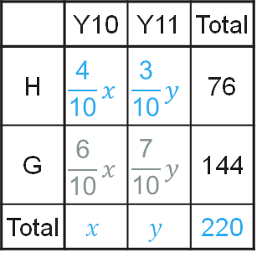
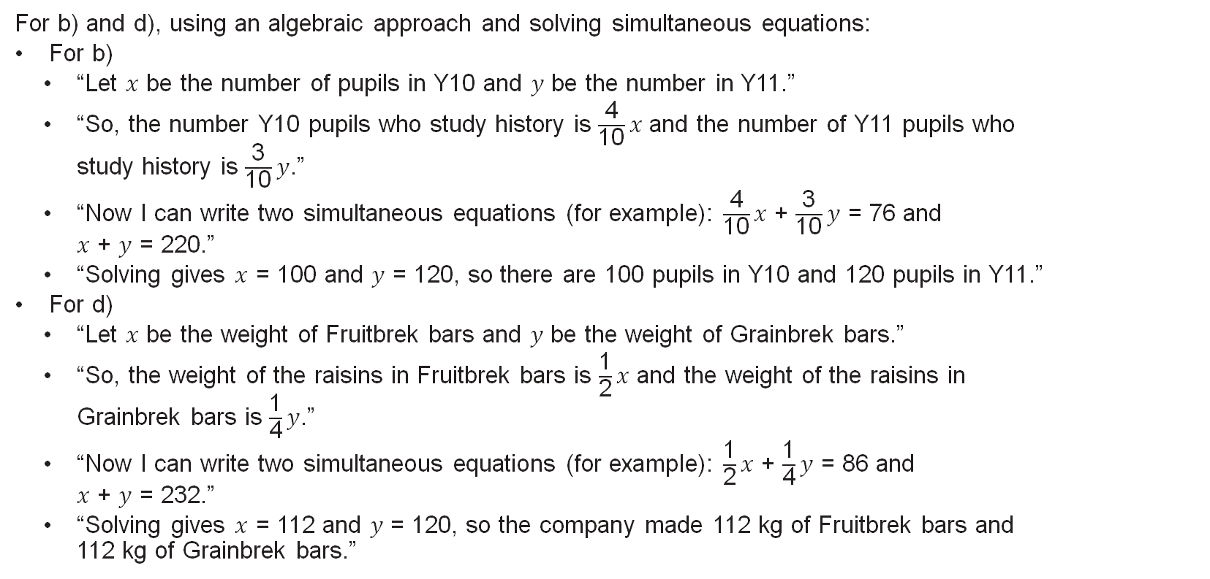
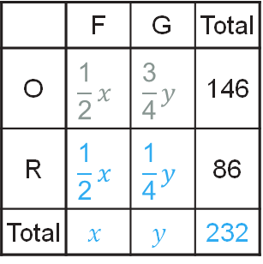
What’s the same, what’s different?
For b) and d), using an algebraic approach and solving simultaneous equations:
For b)
  “Let $x$ be the number of pupils in Y10 and $y$ be the number in Y11.”
  “So, the number Y10 pupils who study history is $\frac{\text{4}}{\text{10}}x$ and the number of Y11 pupils who
  study history is $\frac{\text{3}}{\text{10}}y$.”
  “Now I can write two simultaneous equations (for example): $\frac{\text{4}}{\text{10}}x$ + $\frac{\text{3}}{\text{10}}y$ = 76 and
  $x$ + $y$ = 220.”
  “Solving gives $x$ = 100 and $y$ = 120, so there are 100 pupils in Y10 and 120 pupils in Y11.”
For d)
  “Let $x$ be the weight of Fruitbrek bars and $y$ be the weight of Grainbrek bars.”
  “So, the weight of the raisins in Fruitbrek bars is $\frac{\text{1}}{\text{2}}x$ and the weight of the raisins in
  Grainbrek bars is $\frac{\text{1}}{\text{4}}y$.”
  “Now I can write two simultaneous equations (for example): $\frac{\text{1}}{\text{2}}x$ + $\frac{\text{1}}{\text{4}}y$ = 86 and
  $x$ + $y$ = 232.”
  “Solving gives $x$ = 112 and $y$ = 120, so the company made 112 kg of Fruitbrek bars and
  112 kg of Grainbrek bars.”
 | Y10 | Y11 | Total
H | $$\frac{\text{4}}{\text{10}}x$$ | $$\frac{\text{3}}{\text{10}}y$$ | 76
G | $$\frac{\text{6}}{\text{10}}x$$ | $$\frac{\text{7}}{\text{10}}y$$ | 144
Total | $$x$$ | $$y$$ | 220
 | F | G | Total
O | $$\frac{\text{1}}{\text{2}}x$$ | $$\frac{\text{3}}{\text{4}}y$$ | 146
R | $$\frac{\text{1}}{\text{2}}x$$ | $$\frac{\text{1}}{\text{4}}y$$ | 86
Total | $$x$$ | $$y$$ | 232

Slide 9


What’s the same, what’s different?
These problems are suitable for high-attaining KS4 pupils.
Work through the problems one at a time or show all four on one slide.
Encourage pupils to work in pairs or small groups to solve the problems,
then discuss as a whole class.
If the mathematicians are struggling unproductively, ask:
  “Can you draw a diagram to represent the information in each problem?”
  We’ve suggested a two-way table, but bar models could also be used.
  “What information do you need to find? Can you use a variable to represent this?”
Ask “What’s the same, what’s different about these problems?” Listen for:
  “a) and b) have the same context and c) and d) have another, different context.”
  “I used the same method (simultaneous equations) for b) and d), and another, different method (reverse percentages) for a) and c).”
  “a) and d) have the same answers as each other, and b) and c) also have the same answers as each other.”

