Slide 1
Sample Session B
Square squash

Slide 2
Intellectual property statement
Please note that the materials in this file can only be used for the purposes described on the slides. These materials are not to be shared, copied, sold, duplicated or reproduced with any other institution or third party.
Axiom Maths curriculum materials remain the sole intellectual property of Axiom Maths, with full copyright protection applying unless stated explicitly otherwise.

Slide 3
How can I use the sample sessions?
Our sample sessions are designed as a taster for Axiom Maths circles. Use them with mathematicians that are interested in participating but seeking more information about the programme before committing.
  The content and structure is representative of Axiom Maths sessions.
  The speech bubbles (hidden in presentation view) are included to point out common features of Axiom Maths sessions.
Sample sessions are designed to be useable with larger groups or whole classes at the beginning of Year 7.
Training materials that accompany the sample sessions can be found here.

Slide 6
The problems in this session aim to bring out the distinction between “I can’t do it” and
“No-one can do it, it’s impossible.” Ask questions such as, “How can you convince me
that this won’t work whatever way you try to fit the squares in?”
The mathematicians will develop resilience in the face of problems which they do not solve immediately and will find arguments to show that some cases are impossible, rather than just fail to make them work.

Slide 7
In this sample session, we suggest you may finish the first two ‘core’ problems in one hour. ​ If you have more or less than this time, use the additional problem for ‘rapid graspers’ and the guidance below to organise and structure your taster session(s) as you see fit.
Problem | Guidance | You may need…
Square squash | Introduces the context with an impossible problem. | Worksheets or Polypad
Does it fit? | Justify whether the squares can be arranged in each given rectangle.
Squash it in! | Additional problem for circles or individuals that progress quickly.

Slide 8
Reinforce that they will be working on maths problems together. In maths circles it’s not about competing against each other!

Slide 9
In maths circles you’ll learn to be adventurous, articulate and accepting mathematicians!
The first three sessions in Block 1 each focus on one of the three AAA behaviours of mathematicians.

Slide 10
Square squash
The diagram shows how the squares with sides 1, 2 and 3 can fit without overlapping
in a 3 × 5 rectangle.
There is one square left uncovered.
Is there any smaller rectangle with
whole-number side lengths which will contain
all three squares?
5
3
One square left uncovered
Axiom Maths problems are designed to provide opportunities for mathematical reasoning in simple contexts which are not heavily dependent on the mathematicians’ prior knowledge.

Slide 11
Square squash
The mathematicians arranging the squares in various ways, but not successfully reducing the size of rectangle that they fit into.
“I have to place the 2 × 2 square next to the
3 × 3 square in some way.
That means that either the
length or width of the rectangle
has to be at least 5. And
because the 3 × 3 has to fit in
the rectangle, the other
dimension has to be at least 3,
so I can’t get smaller
than 5 × 3.”
“But wait, the reason is simpler than that! The total area of the squares is 1² + 2² + 3² = 14, so they can’t fit in a rectangle with area less than 14. Only a 1 × 14 rectangle or a 2 × 7 rectangle have area 14, and the 3 × 3 square can’t fit into either of these.”
This problem is impossible. The purpose
is for the mathematicians to justify why
the problem is impossible. Don’t rush them to this conclusion. Give them time to be adventurous independently first.
Whether working online or in person, give the mathematicians squares that they can move around, rather than drawing them each time.
To bring out at least one of the approaches,
ask “What could a rectangle with a smaller
area look like?” Listen for
  “It would have to have width less than 3 or length less than 5.”
  or “It could have area 14 or 13 or… .”
“Have you been able to use a smaller rectangle? Do you think it’s possible? Convince me!” You can use the grid on the next slide to support these group discussions.
If the detailed ‘area reasoning’ justification does not arise here, wait until a) of the next problem before bringing it out from them.
3
5

Slide 12
3
2
1
Ask one (or more) of your mathematicians to explain why they think this problem is impossible. Encourage them to visually illustrate their explanations on this slide to support their reasoning.

Slide 13
Does it fit?
Explain why it’s impossible to fit squares with sides
1, 2, 3, 4, 5, 6 and 7 in an 8 × 17 rectangle.
3
2
1
7
6
5
4

Slide 14
Does it fit?
The mathematicians re-arranging their squares and trying to fit them into the
8 × 17 rectangle.
“I worked out the sum of the areas of the squares first.
1² + 2² + 3² + 4² + 5² + 6² + 7² = 140.
But the area of the 8 × 17 rectangle is only 8 × 17 = 136, so the squares can’t possibly fit. There’s not enough room!”
If the mathematicians say “It’s impossible, I’ve tried and I can’t fit the squares in”, ask “How can you be sure no one else will be able to fit them in?”
Encourage them to work systematically. Ask “Which square are you trying to fit in first? Where are you choosing to put it?” Use the next slide to support these discussions.
“Did anyone justify why the squares will not fit into the 8 × 17 rectangle differently?”
If it doesn’t come from them, bring out the ‘area reasoning’ justification here: if the area of the rectangle is less than the sum of the areas of the squares then it’s not possible for the squares to fit. Ask “Can you tell me something about the areas of the squares that is relevant here?”

Slide 15
Does it fit?
Explain why it’s impossible to fit squares with sides
1, 2, 3, 4, 5, 6 and 7 in an 8 × 17 rectangle.
7
6
5
4
8
3
2
1
17

Slide 16
Does it fit?
Explain why it’s impossible to fit squares with sides
1, 2, 3, 4, 5, 6 and 7 in an 8 × 17 rectangle.
Show that squares with sides 1, 2, 3, 4, 5, 6 and 7
  will fit in an 11 × 14 rectangle
  but will not fit in a 10 × 17 rectangle.
3
2
1
7
6
5
4

Slide 17
Does it fit?
Show that squares with sides 1, 2, 3, 4, 5, 6 and 7 will fit in a 11 × 14 rectangle but will not fit in a 10 × 17 rectangle.
7
6
5
4
3
2
11
1
14

Slide 18
Does it fit?
The mathematicians justifying that they will fit into the 11 × 14 rectangle by:
  Finding at least one example where the squares fit. Listen for “I started with the largest squares, as they are the hardest to fit in. Then I fitted the smaller squares around them. I had lots of choices.” Praise the mathematicians for taking a systematic approach. One example is shown here (see right).
  Or by using ‘area reasoning’.
    “The sum of the areas of the squares is 140, so I think they will fit into an
    11 × 14 rectangle because the area of the rectangle is 154.”
    Now ask if they are certain that the squares will fit in and listen for “I don’t know for sure that they will be able to. I’ll try it out and see… .”
    And then “… ah yes! It works.”
Bring out that it is not correct to claim that “The area of the rectangle is greater than the sum of the areas of the squares so the squares must fit.”. They need to find an example. Catalyse conversations by asking “Is ‘area reasoning’ enough to show
that the squares must fit?”
 |  |  |  |  |  |  | 6
7
 |  |  |  |  |  |  |  |  |  |  |  | 2
 |  |  |  |  |  |  |  |  |  |  |  | 1
 |  |  |  | 3
4 |  |  |  |  |  |  | 5

Slide 19
Does it fit?
Show that squares with sides 1, 2, 3, 4, 5, 6 and 7 will fit in a 11 × 14 rectangle but will not fit in a 10 × 17 rectangle.
7
6
5
4
3
10
2
1
17

Slide 20
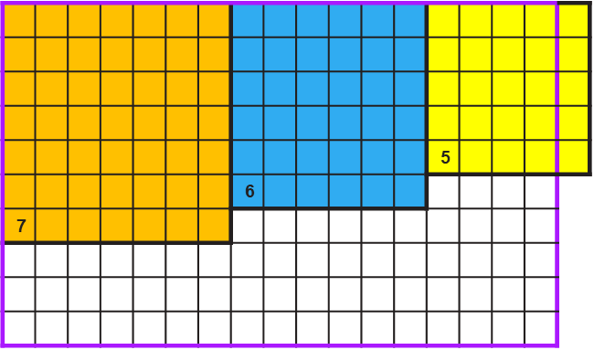
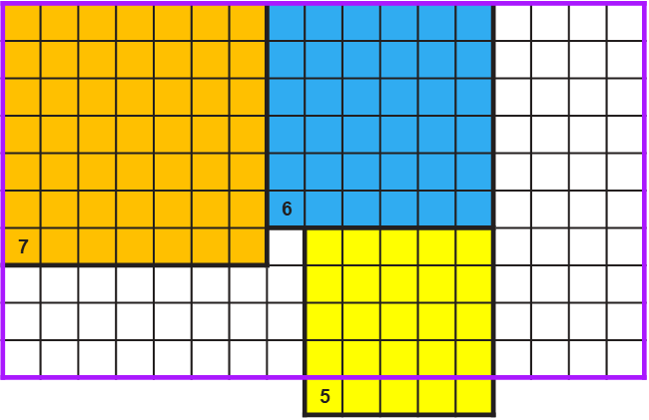
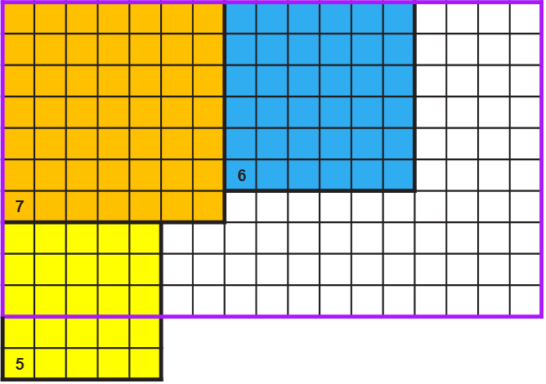
Does it fit?
The mathematicians justifying that they will not fit into the 10 × 17 rectangle by:
  Trying to arrange the squares of length 7 and 6 in a way that ‘leaves room’ for the square of length 5 and then showing that there is no way to make this work.
  Or by using ‘area reasoning’. Listen for “The sum of the areas of the squares is smaller than the area of the rectangle, so it might be possible to fit the squares in… I don’t know for sure though. I’ll need to try it out and see…”
  …and then “Uh-oh. This time it’s not possible! There’s no way that I can fit the squares of lengths 7, 6 and 5 into the rectangle because 7 + 6 + 5 is more than 17, and 7 + 6 and 6 + 5 and 7 + 5 are all more than 10.”

Slide 21
Does it fit?
“Can you tell me something about the values of the lengths of the squares that is stopping you from fitting them all in?”
Ask the mathematicians to reflect on what they have learned and to articulate what the ‘area reasoning’ tells them. Ask “If the area of a rectangle is greater than the sums of the areas of the squares, what does this tell you? What doesn’t it tell you?” Listen for:
  “It tells you that it might be possible for the squares to fit because the area of the rectangle cannot be less than the sum of the areas of the squares.”
  “But it doesn’t tell you that it must be possible. You need to find an example to be certain.”

Slide 22
Does it fit?
Find the smallest rectangle with whole-number side lengths in which squares with sides
1, 2, 3, 4 and 5 will fit without overlapping.
3
2
1
5
?
4
?

Slide 23
Does it fit?
The mathematicians ‘building’ a big-enough rectangle by arranging the squares and drawing a rectangle which contains the squares:
  “I placed the square with length 5 next to the square with length 4. Then I had a few choices of where to put the square with length 3.”
  “Look, I can fit them into a 7 × 9 rectangle that has area 63.”
Give the mathematicians time to
be adventurous and to work in
small groups to come up with their own solutions before prompting them.
Promote collaboration by bringing
them back together to discuss their solutions. If they have been successful with this ‘building’ method, ask “Are you sure that you can’t fit the squares into a smaller rectangle? Convince me.”
They can rule out smaller possibilities by drawing rectangles with smaller areas and justifying why they can’t contain the squares. Bring this out using the prompts on the next slide.
 |  | 4
 |  |  |  |  | 1 | 5
 |  | 3 |  |  | 2

Slide 24
Does it fit?
The mathematicians working systematically starting from the smallest possible area.
  “The sum of the areas of the squares is 55 so the rectangle must have area at least 55.
  I can’t use a 5 × 11 rectangle because
  5 + 4 + 3 is more than 11.”
  “I’ll try a rectangle of area…
    …56. This can be 7 × 8 or 14 × 4 or
    28 × 2 or 56 × 1. Only 7 × 8 will contain the square of length 5 but I can’t also fit in the square of length 4.”
    …57. This will be far too ‘narrow’. Its only factor pairs are 1 × 57 and 3 × 19. I can’t fit anything bigger than the square of length 3 into these.”
    …58. 1 × 58 or 2 × 29 work but both are too ‘narrow’. 58 doesn’t have a factor pair in which both factors are 5 or greater.”
    …59. This is worse because 59 is a prime number! The only possibility is 1 × 59, so I can only fit in the square of length 1.”
    …60. Hmm, I can’t make 6 × 10 work. I’ll try 5 × 12 … yes, this works!” (see right)
The purpose is for them to apply what they learned in a) and b) to solve this problem systematically starting from the smallest possible area. If necessary, ask:
  “What is the smallest area the rectangle can be for the squares to fit? What can you tell me about the dimensions of the rectangle?”
  “Why can’t you have a [P × Q] rectangle?”
  When they get to 59, ask “How can you tell without trying that the squares won’t fit into a rectangle with an area of 59?” Give some thinking time. If necessary, ask “What can you tell me about the factors of 59?”
 |  |  |  |  |  |  |  |  | 3
 |  |  |  |  | 4 |  |  |  | 1
5 |  |  |  |  |  |  |  |  |  | 2

Slide 25
Does it fit?
After they’ve solved the problem, “I now know that 5 × 12 works, but I wonder why
6 × 10 didn’t work. I’ll investigate… Wherever I put the squares with lengths 4 and 5 in the rectangle, there’s no space for the square with length 3. The problem is that 5 + 4 + 3 is more than 10 (see below) and also both 5 + 3 and 4 + 3 are more than 6.” (see right).
“So even though the smallest rectangle where the squares fit has area 60, it doesn’t mean that the squares will fit into any rectangle with area 60. The 5 × 12 is important to specify.”
Ask for an articulate explanation (drawn or verbal) why the squares won’t fit into a
6 × 10 rectangle, which also has
area 60.
You will likely need to bring out this curiosity, and reiterate to them that ‘the answer is only the beginning!’
 |  |  |  |  |  |  |  |  | 3
 |  |  |  |  | 4
5
 |  |  |  |  | 4
5
3
 |  |  |  |  | 4
5
 |  |  |  |  |  | 3

Slide 26
Today, you have you been…
After failing to fit the squares in the rectangle a few times,
I tried a different strategy and used ‘area reasoning’ instead.
At the end of each Axiom Maths session (as well as throughout), the mathematicians reflect on how they have shown AAA behaviour in this session!
I explained to my partner that ‘area reasoning’ only tells you that it might be possible for the squares to fit.
I asked my partner what strategy they used when they fitted the squares with sides 1, 2, 3, 4 and 5 into a smaller rectangle than me.

Slide 27
Today, you have you been…
Allow 2 minutes at the end of the session to tell the mathematicians how they have demonstrated the three AAA behaviours of mathematicians today.
Ask them to reflect on what they enjoyed about this session, and how it might have been different from a normal maths lesson.
“Is there somebody who you think has been especially adventurous/articulate/accepting today? What did they do?”
The first three sessions in Block 1 each focus on one of the three AAA behaviours of mathematicians.

Slide 29
Squash it in!
Can squares with sides 1, 1, 2, 3, and 5 fit exactly into a rectangle, with no squares
left uncovered?
5
3
2
1
1

Slide 30
Squash it in!
Can squares with sides 1, 1, 2, 3, and 5 fit exactly into a rectangle, with no squares
left uncovered?
Can squares with sides 1, 1, 2, 3, 5 and 8 fit exactly into a rectangle, with no squares
left uncovered?
8
5
3
2
1
1

Slide 31
Squash it in!
For a)
“I’ll work out the sum of the areas of the squares first. 1² + 1² + 2² + 3² + 5² = 40. The factor pairs of 40 are 1 × 40, 2 × 20, 4 × 10 (which are too small) and 5 × 8.”
Or the mathematicians
‘building’ a big-enough
rectangle by arranging the
squares and drawing a
rectangle which contains
the squares.
“I can fit them into a 5 × 8
rectangle that has area 40.”
For b)
“I can add the square with length 8
onto the side of my rectangle from part a) to form an 8 × 13 rectangle that has area 104.
“Are your solutions unique?” Listen for “Yes, because 40 and 104 don’t have any other pairs of factors which would make rectangles that could fit the largest square inside.”
“What size squares could you add next?” Listen for
  “A square with length 13 which would make a 13 × 21 rectangle.”
  “Then I could add square with length 21… wait! I recognise this sequence of numbers!”
 |  |  | 2
3 |  |  | 1 | 1
5
 |  |  | 2
3 |  |  | 1 | 1
5 |  |  |  |  | 8

Slide 32
Squash it in!
The Fibonacci numbers are the numbers in this list.
1, 1, 2, 3, 5, 8, ...
Each number in the list is the sum of the two previous numbers in the list.
Will squares with side lengths that are
Fibonacci numbers always fit exactly
into a rectangle, with no squares left
uncovered?
3
2
8
1
1
5

Slide 33
Squash it in!
“Each rectangle’s width and length are two consecutive Fibonacci numbers. For example, 5 × 8 or 8 × 13.”
“That means that the sum of the width and length is the next Fibonacci number after that.”
“Then I add a square on the long side of the rectangle.
“Now, the new width is the old length, which is a Fibonacci number.”
“Also, the new length is the sum of the old width and length. And this equals the next Fibonacci number!”
“So squares with side lengths that are Fibonacci numbers will always fit exactly into a rectangle, with no squares left uncovered. I could keep adding squares forever!”
The aim is for the mathematicians to move from “it works for these cases” to “it will always work, and here’s why.”
If the mathematicians are struggling unproductively, ask
  “What do you notice about the dimensions of the rectangles?”
  “When you add the next square, how does the rectangle change?”
“What about if the smallest square has side length 2? Do the squares fit exactly into a rectangle then?” Listen for “No, it only works if I start at the beginning of the sequence, (1, 1, 2, …) and use every Fibonacci number in order without skipping any.”

